Slide 1

EEE 411 / ECR 308 PROJECT PRESENTATION
Designing a Simple Cruise Control System Using Closed-Loop Unity Feedback
& PI controller
Presented by:
Faiyaz Ahmed (ID : 1820545)
Jarin Tasnim supti (ID : 1820759)
Department of Electrical & Electronic Engineering
INDEPENDENT UNIVERSITY, BANGLADESH
Course Instructor: Prof. Md. Abdur Razzak
Jarin Tasnim Supti Cruise Control System Page 1/16

Slide 2
Outline
Background, Motivation and Objectives
Research Methodology
Proposed System’s Diagram
Circuit Design and Parameters
Simulation Results
Impact of project on the environment and sustainability
Summary
Jarin Tasnim Supti Cruise Control System Page 2/16

Slide 3
Background and Motivation (Literature Review)
Sl | Reference (Journal / Conference papers | Outcome | Limitations / Problems / Challenging issues | Proposed Solution
1. | Lingyun Xiao & Feng Gao (2010) A comprehensive review of the development of adaptive cruise control systems, Vehicle System Dynamics: International Journal of Vehicle Mechanics and Mobility, 48:10, 1167-1192 | N/A | N/A | N/A
2. | C. Liang, Traffic-friendly adaptive cruise control design, Ph.D. Diss., University of Michigan, 2000. | has shown that PID controllers work very well as longitudinal controllers |  | Use ACC controller is the as upper-level controller, and longitudinal controller as lower level controller
3. | Bill Messner, Dawn Tilbury, Rick Hill, “Cruise Control: PI Controller Design”, http://ctms.engin.umich.edu/CTMS/index.php?example=CruiseControl&section=ControlPID | Tutorial on design and analysis of cruise control system on MATLAB and Simulink | N/A, Tutorial | Custom Simulink Models made publicly available as examples on MathWorks website.
Jarin Tasnim Supti Cruise Control System Page 3/16

Slide 4
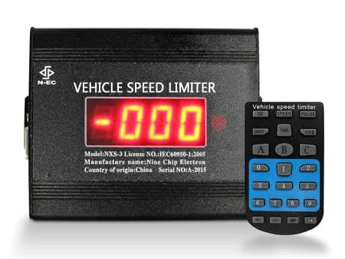
Background and Motivation (contd..)
Background
Speed control was used in automobiles as early 19th century in the Wilson-Pilcher and in the 1910s by Peerless.
Electronic speed control was used in automobiles as Late 20th century.
Modern cruise control was invented by the inventor and mechanical engineer.
Motivation
Less chance of accidents
Easier and more comfortable driving
Reduce tire wear
Reduce overall fuel consumption
Jarin Tasnim Supti Cruise Control System Page 4/16

Slide 5
Objectives
Maintain a constant speed of 30m/s
Rise time<5s
Settling time<15s
Overshoot <5%.
Steady-state error < 2%
Jarin Tasnim Supti Cruise Control System Page 5/16

Slide 6
Research Methodology
Step 1:
Literature Review
Step 2:
Define Project Deliverables
Step 3:
Define Design
Parameters
Step 6:
Result Analysis
Step 5:
Simulate the System
Step 4:
Design the Cruise Control System
Jarin Tasnim Supti Cruise Control System Page 6/16

Slide 7
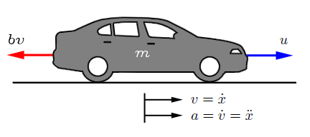
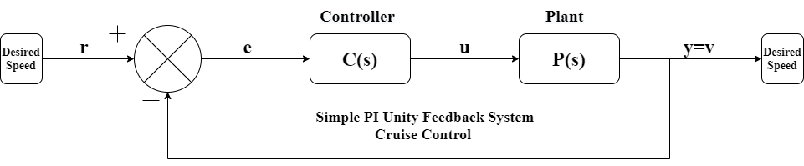
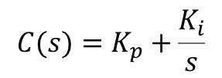
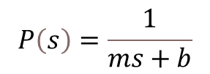
Proposed System’s Block Diagram
Figure: Free-body diagram
Figure: Block diagram of the control system
$$P\left(s\right)=\frac{1}{ms+b}$$
$$C(s)=K_{p}+\frac{K_{i}}{s}$$
Faiyaz Ahmed Cruise Control Page 7/16

Slide 8
Circuit Design and Parameters
Transient Parameters:
Rise time < 5 s
Settling time < 15s
Overshoot < 5%
Steady-state error < 1%
System parameters:
m = vehicle mass = 1200 kg;
b = damping coefficient = 35 N.s/m;
r = reference speed = 30 m/s;
Faiyaz Ahmed Cruise Control Page 8/16

Slide 9
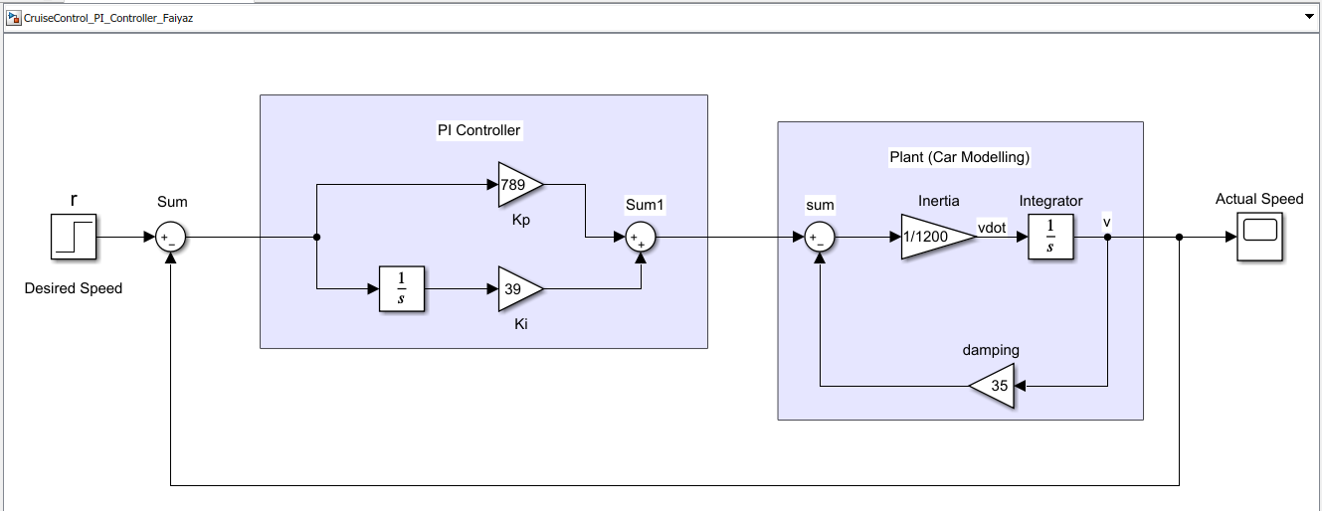
Simulation Circuit
Figure: Simulated model
Faiyaz Ahmed Cruise Control Page 9/16

Slide 10
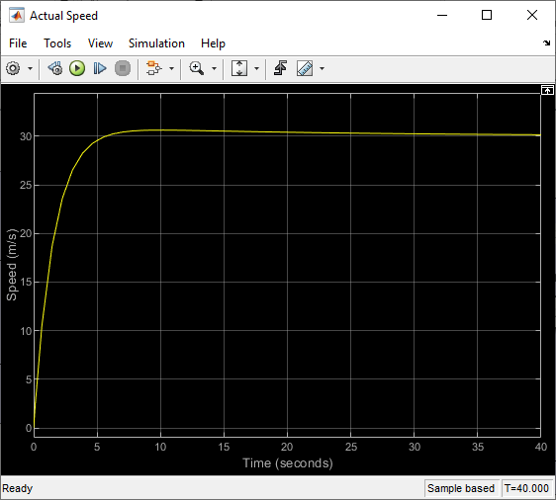
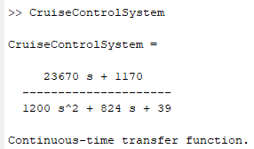
Simulation Results
Characteristics | Value
Rise Time | 3.09s
Settling Time | 11.8s
Overshoot | 2.07%
Peak Amplitude | 30.6
Peak Time | 10s
Steady State Speed | 30 m/s
Steady State Error | 0 m/s
The damping factor is 0.343
Natural frequency is 0.180
The damping ratio is 1.906
Figure: Continuous time transfer function
Faiyaz Ahmed Cruise Control Page 10/16

Slide 11
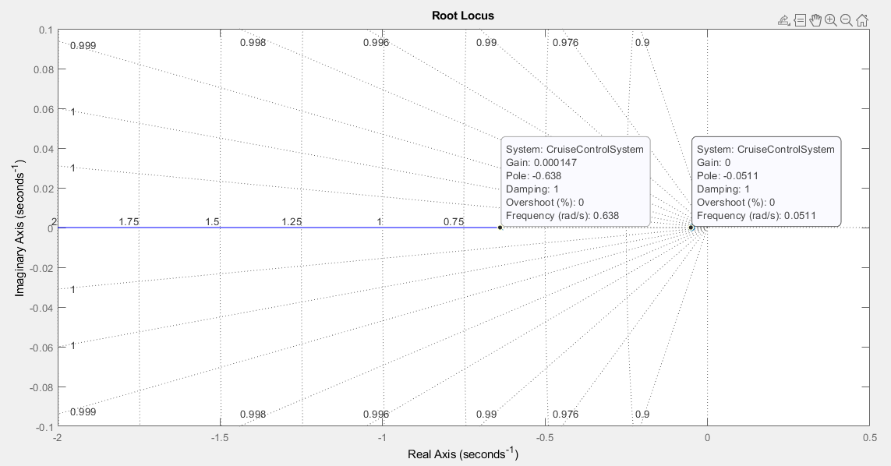
Simulation Results – Root Locus
Faiyaz Ahmed Cruise Control Page 11/16

Slide 12
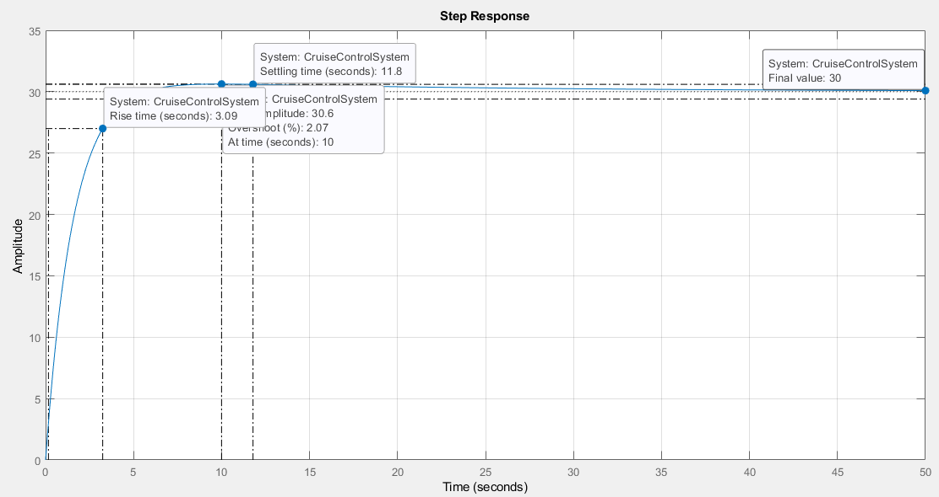
Simulation Results – Step Response
Faiyaz Ahmed Cruise Control Page 12/16

Slide 13
Impact of project on environment & sustainability
Increase fuel efficiency
Less tire wear
Helps contribute to reduced exhaust gas emmission
Faiyaz Ahmed Cruise Control Page 13/16

Slide 14
Summary
Both poles are real and distinct → the system is an overdamped system → Stable
The damping factor is 0.343
Natural frequency is 0.180
The damping ratio is 1.906
k_{p} = 789 and k_{i} = 39
Vehicle mass 1600kg,
Damping coefficient 35 N.S/m,
The desired speed was 30 m/s.
Faiyaz Ahmed Cruise Control Page 14/16

Slide 15
Code to Verify Simulink Output
m = 1200;
b = 35;
r = 30;
Kp = 789;
Ki = 39;
Kd = 0;
t = 0:0.1:50;
s = tf('s');
C = pid(Kp,Ki,Kd);
P_cruise = 1/(m*s + b);
T = feedback(C*P_cruise,1);
CruiseControlSystem = r*T;
figure('Name','Cruise Control','NumberTitle','off');
step(CruiseControlSystem ,t)
axis([0 50 0 r+5])
grid on; grid minor;
figure('Name','Cruise Control','NumberTitle','off');
rlocus(CruiseControlSystem)
grid on; grid minor;
CruiseControlSystem
Faiyaz Ahmed Cruise Control Page 15/16

Slide 16

Any questions, comments or suggestions?
Faiyaz Ahmed Cruise Control Page 16/16

